Slide 1
Exception handling

Slide 2
Exceptions are run time errors.
Types of errors
1. syntax errors: missing semicolon, z is used by not declared, using variables without initialization. typing mistakes
2. logical errors: not getting expected result, e.g.-b/2*a needs to be written as –b/(2*a), difficult to remove, debuggers used to help to find out logical errors or tracing of program need to done
3. runtime errors: user can’t modify program so not able to remove them. Reason for runtime error, wrong input, file not found ,
1 & 2 errors are faced by programmers
And 3 errors are faced by user.(these are exceptions)
Compilers finds out syntax errors.

Slide 3
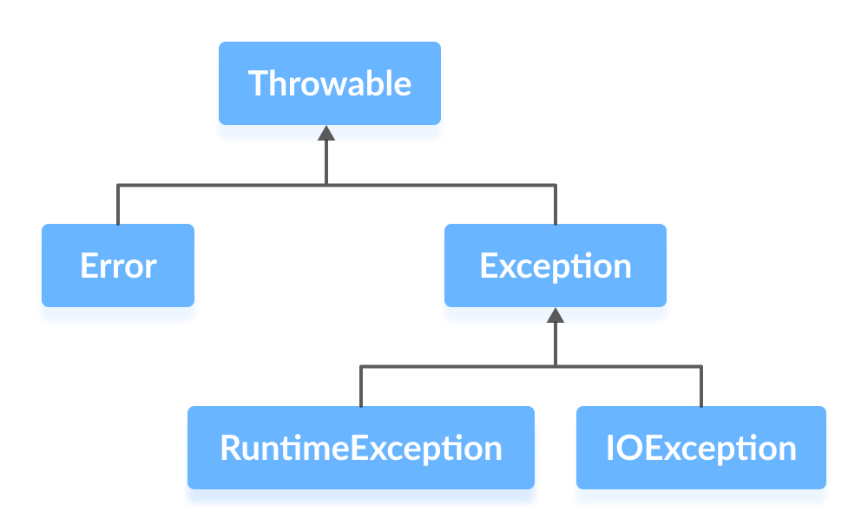
An exception is an unexpected event that occurs during program execution. It affects the flow of the program instructions which can cause the program to terminate abnormally.
Exception Hierarchy in Java

Slide 4
Runtime error: bad input, resource unavailable so programs crash.
If error, programs stop, so solution is, inform users about program what should to done, programmer dose changes in program to give proper messages to user . This is called as exception handling.(program won’t stop in between)
In programs exceptions are identified and handled by programming for smooth running of program.

Slide 5
Exception Handling
Try … catch block
Finally block
Throw and throws keyword

Slide 6
class Test
{
public static void main(String args[])
{
int a,b,c;
a=5,b=0;
c=a/b;
System.out.println( c );
System.out.println (“End of the program”);
}
}
Output
Exception in thread "main" java.lang.ArithmeticException: / by zero
at Test.main(Test.java:7)

Slide 7
By handling exception program don’t crash, remaining part of program should run smoothly. To handle exception use try and catch.
class Test{
public static void main(String args[])
{
int a,b,c;
try{
a=10; b=0;
c=a/b;
System.out.println(c);
}
catch(ArithmeticException e)
{
System.out.println( “Division by 0 is not possible ”);
}
System.out.println (“End of the program”);
}
OUTPUT:
Division by 0
End of Program

Slide 8
More than one exception then use single try and multiple catch.
try {
int A[]={10,0,8,3,5};
int r;
r=a[0]/a[1];
System.out.println(r);
System.out.println(A[10]);
}
catch(ArithmeticException e)
{
System.out.println(e);
}
catch(ArrayIndexOutOfBoundsException e)
{
System.out.println( e );
}
Output
java.lang.ArithmeticException: / by zero
End of Program

Slide 9
try
{
int A[]={10,0,8,3,5};
try
{
try
{
System.out.println(A[10]);
int r=A[0]/A[1];
System.out.println( r);
}
catch(ArrayIndexOutOfBoundsException e)
{
System.out.println( e );
}
}
catch(ArithmeticException e)
{
System.out.println( e );
}
output
java.lang.ArithmeticException: / by zero
java.lang.ArrayIndexOutOfBoundsException: Index 10 out of bounds for length 5

Slide 10
A finally block contains all the crucial statements that must be executed whether exception occurs or not. The statements present in this block will always execute regardless of whether exception occurs in try block or not such as closing a connection, stream etc.
try
{
---
}
catch()
{
---
}
catch()
{
---
}
finally
{
----- //used for clean up process, definitely executed
}

Slide 11
Exception Hierarchy

Slide 12
Built in Exceptions
Object(super class for all java classes)
Throwable(super for Exception and Error)
Exception Error(not much worry as it is handled by JVM)
ClassNotFoundException
IOException
SQLException
InvocationTargetException
InterruptedException
RuntimeException
ArithmeticException
IndexOutOfBoundsException
NullPointerException
IllegalFormatException
NumberFormatException

Slide 13
Checked exception (must handle them by try and catch or declared the exception i.e. specified throws keyword with the method.)
Unchecked exception ( you can handle or don’t handle), (runtime exceptions are unchecked exception)
Exception class Methods
String getMessage() (S.O.P.(e.getMessage();)
String toString() (S.O.P.(e);)
void printStackTrace() (e.printStackTrace();)

Slide 14
User defined exceptions
Minbalance=5000
class MinbalanceException extends Exception
{
public String toString()
{
return “minimum Balance must be 5000, try again with smaller amount” ;
}
}

Slide 15
Unchecked Exception
public class CheckedUnchecked{
static void fun1()
{
try{
System.out.println(10/0);
}
catch(Exception e){
System.out.println(e.getMessage());
}
}
static void fun2()
{
fun1();
}
static void fun3()
{
fun2();
}
public static void main(String args[])
{
fun3();
}
}

Slide 16
Checked Exception:use throws or use try catch. Checked exceptions are not forwarded in calling chain (propagated).
public class CheckedUnchecked{
static void fun1(){
try{
fileInputStream fi=new FileInputStream(“My.txt”);
}
catch(Exception e){
System.out.println(e.getMessage());
}
}
static void fun2()
{
fun1();
}
static void fun3()
{
fun2();
}
public static void main(String args[])
{
fun3();
}
}

Slide 17
User defined or custom Exceptions in java:
class LowBalanceException extends Exception
{
public String toString()
{
return "Balance should not be less than 5000";
}
}
public class CheckedUnchecked1{
static void fun1()
{
try{
throw new LowBalanceException();
}
catch(LowBalanceException e){
System.out.println(e);
}
}
static void fun2()
{
fun1();
}
static void fun3()
{
fun2();
}
public static void main(String args[])
{
fun3();
}
}

Slide 18
import java.util.*;
class IncorrectPasswordException extends Exception
{
public String toString()
{
return “Password dosen’t match";
}
}
public class CheckPassword{
String password;
Scanner sc=new Scanner(System.in);
void fun1()
{
System.out.println("Enter Password");
password=sc.next();
if(!password.equals(“123456”)
{
try{
throw new IncorrectPasswordException();
}
catch(IncorrectPasswordException e){
System.out.println(e);
}
}
else{
System.out.println(“Authentication Successful");
}
}
public static void main(String args[])
{
CheckPassword s = new CheckPassword();
s.fun1();
}
}

Slide 19
Throw vs Throws
class NegativeDimensionException extends Exception{
public String toString()
{
return "Dimensions cannot be negative";
}
}
public class ThrowThrowsDemo1 {
int area(int l,int b)throws NegativeDimensionException
{
if(l<0||b<0)
throw new NegativeDimensionException();
int a=l*b;
return a;
}
public static void main(String args[]) {
ThrowThrowsDemo1 t=new ThrowThrowsDemo1();
try{
System.out.println("Area is:"+t.area(1,-2));
}
catch(NegativeDimensionException e){
System.out.println(e);
}
}
}
Output
Dimensions cannot be negative

Slide 20
throw | Throws
Java throw keyword is used throw an exception explicitly in the code, inside the function or the block of code. | Java throws keyword is used in the method signature to declare an exception which might be thrown by the function while the execution of the code.
Type of exception Using throw keyword, we can only propagate unchecked exception i.e., the checked exception cannot be propagated using throw only. | Using throws keyword, we can declare both checked and unchecked exceptions. However, the throws keyword can be used to propagate checked exceptions only.
The throw keyword is followed by an instance of Exception to be thrown. | The throws keyword is followed by class names of Exceptions to be thrown.
throw is used within the method | throws is used with the method signature.
We are allowed to throw only one exception at a time i.e. we cannot throw multiple exceptions. | We can declare multiple exceptions using throws keyword that can be thrown by the method. For example, main() throws IOException, SQLException.

Slide 21
Finally:
public class FinallyDemo {
static void meth1() throws Exception
{
try{
throw new Exception();
}
finally{
System.out.println("final Message");
}
}
public static void main(String args[])// throws Exception {
try{meth1();}catch(Exception e){}
}
}
Output
final Message
Exception in thread "main" java.lang.Exception
at FinallyDemo.meth1(FinallyDemo.java:6)
at FinallyDemo.main(FinallyDemo.java:15)

